Slide 1


Ava-Scope
Real-Time, AI-Powered Metrics Dashboard for Avalanche Subnets/L1s
Oliver Tipton

Slide 2

Data Observability
Adoption
Lack of Transparent tooling
Target Audience
Avalanche Subnets are rapidly gaining adoption
Enterprises, gaming, and DeFi protocols are launching Subnets to escape L1 congestion and control their execution environment
Cross-chain Teleporter traffic
Validator distribution
Contract deployments
On-chain activity (TPS, gas, ERC-20 transactions / day)
Not just for developers
Built robust enough for developers, but digestible enough for anyone
Can be used by a CTO or by a marketer

Slide 3

Introducing AvaScope
Real-Time dashboard for Avalanche Subnets
AI Agent with access to Subnet data specific to the user, making it easy and accessible for anyone
Cross-chain Teleporter metrics (messages in/out), Staking: validator & delegator counts and weight, Contracts deployed over time, Active address engagement, TPS, gas utilization, ERC20 transfers

Slide 4
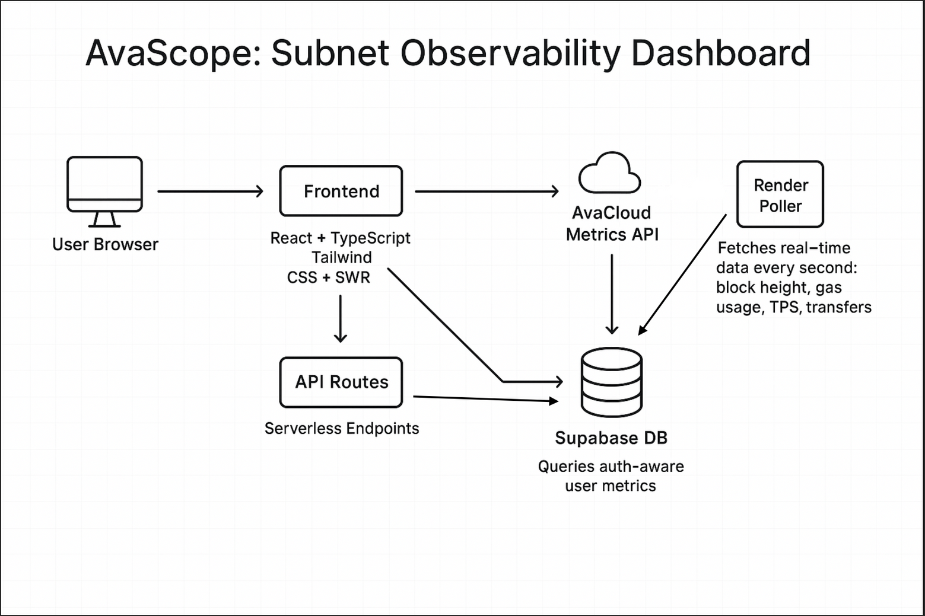
System Architecture

Slide 5
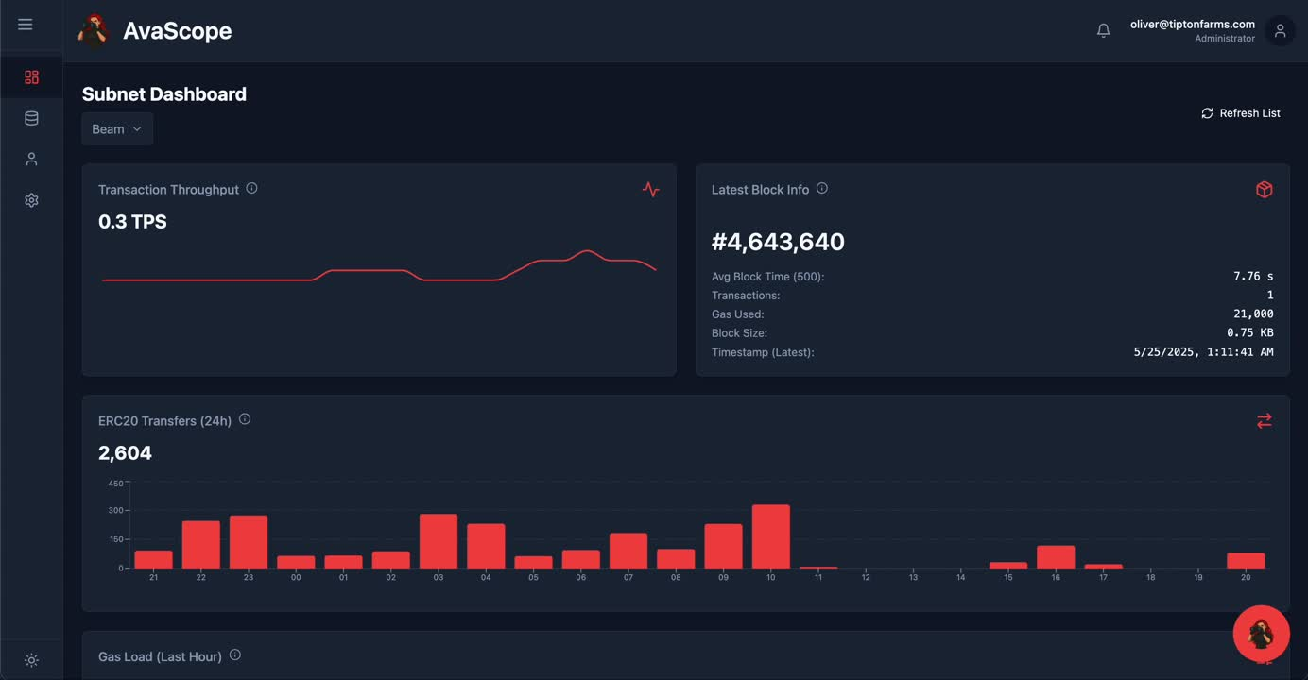
DEMO

Slide 6

Roadmap
Today
June
July
Present MVP
Built dashboard with AI Agent that has access to all your L1 or Subnet Data
Include more metrics
Add alerts
Waitlist for partners
Deploy publicly
Create and publish API endpoints & Library

Slide 7

Thank You
Oliver Tipton
Telegram: @oltipton
X: @MrOliverpt
Github: https://github.com/Oliverpt-1

